Slide 1

Sport Scope Dashboard: A Comprehensive Data Visualization & Forecasting Tool
Welcome to the presentation on Sport Scope Dashboard, a GUI application designed to empower non-technical users to analyze data using machine learning and visualization.

Slide 2
Overview of Sport Scope Dashboard
Data Upload
Data Visualization & Charts
Forecasting
File Conversion & Dashboards
Choose from Linear, Polynomial, or ARIMA forecasting models and visualize predictions with confidence intervals.
Intuitive interface for uploading CSV or Excel files. Automatic column detection effortless data preparation.
Create custom charts using Plotly, explore various chart types like scatter, bar, line, and more.
Convert data between CSV, Excel, and SQLite formats. Design custom dashboards to combine multiple charts and insights.

Slide 3

Hardware Requirements
Dual-core CPU (Intel i3 or equivalent) and 4 GB RAM. 8 GB RAM recommended for optimal performance.
At least 500 MB of free disk space. Graphics card for enhanced plot rendering (optional).

Slide 4

Software Requirements
Operating System
Windows, macOS, or Linux.
Programming Language
Python 3.x.
Key Libraries & Frameworks
Tkinter, ttkbootstrap, pandas, numpy, Plotly, scikit-learn, statsmodels, sqlite3.
Additional Tools
A code editor (e.g., VS Code, PyCharm).

Slide 5
Workflow: From Data Upload to Insights
File & Data Upload
1
Browse and upload CSV or Excel files. The system automatically detects columns and displays options.
2
Data Visualization
Select columns and chart type to create custom visualizations using Plotly.
Forecasting
3
Enable prediction mode, choose a forecasting model (Linear, Polynomial, ARIMA), and set the horizon.
4
File Conversion
Convert uploaded files to CSV, Excel, or SQLite format as needed.
Custom Dashboard Creation
5
Define the number of charts and select options for each to create a custom dashboard.
6
Settings & Customization
Modify UI fonts, colors, and overall appearance to suit your preferences.

Slide 6





Key Advantages of Sport Scope Dashboard
User-Friendly
Multi-Functionality
Customization
Rapid Analysis
Intuitive interface with a three-pane layout for easy navigation.
Combines data upload, visualization, forecasting, and file conversion in one tool.
Create custom charts, dashboards, and adjust themes and appearance.
Quickly gain insights and forecasts from raw data.
Versatility
Supports multiple file formats and machine learning forecasting models.

Slide 7
Modular Design: Building Blocks of Functionality
File & Data Module
Handles file uploads, reading data, and updating column dropdowns.
File Converter Module
Converts files between CSV, Excel, and SQLite formats.
Forecasting Module
Provides prediction functionality using Linear, Polynomial, and ARIMA models.
Custom Chart & Dashboard Module
Enables users to generate individual charts and combine them into a dashboard.
Settings Module
Manages UI customization (fonts, colors, themes) and resets defaults.
Visualization Module
Generates various chart types (scatter, bar, pie, 3D, etc.) using Plotly.

Slide 8
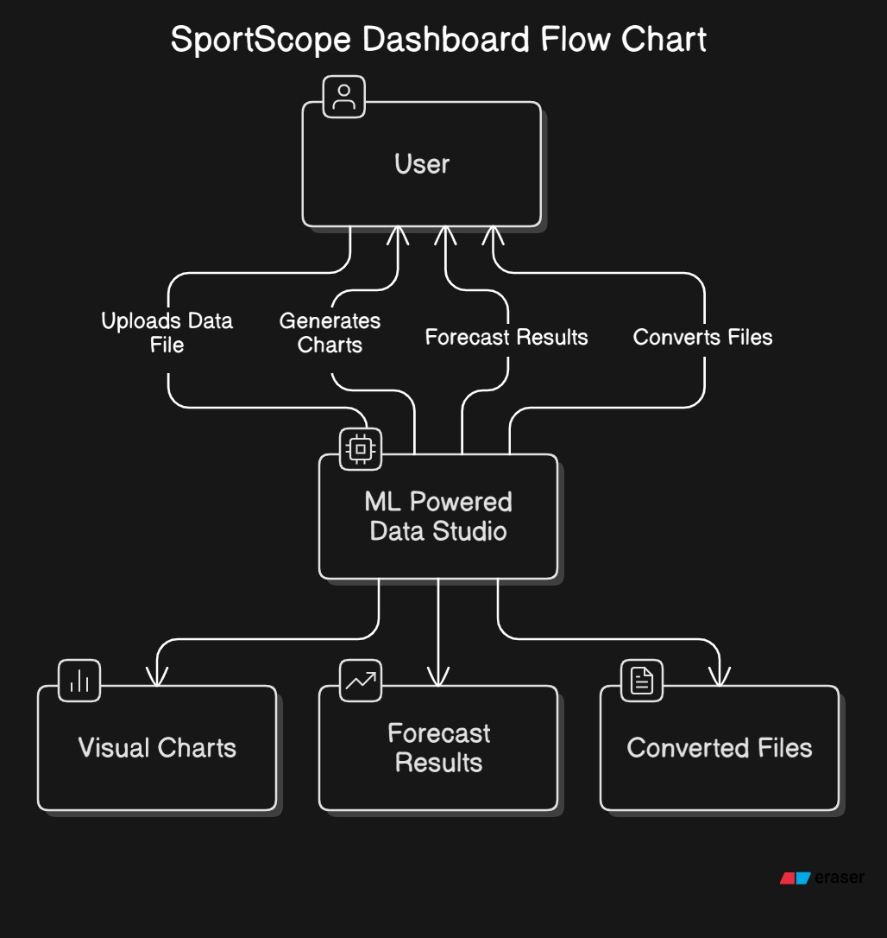
Data Flow Diagram (DFD)
DFD Level 0

Slide 9
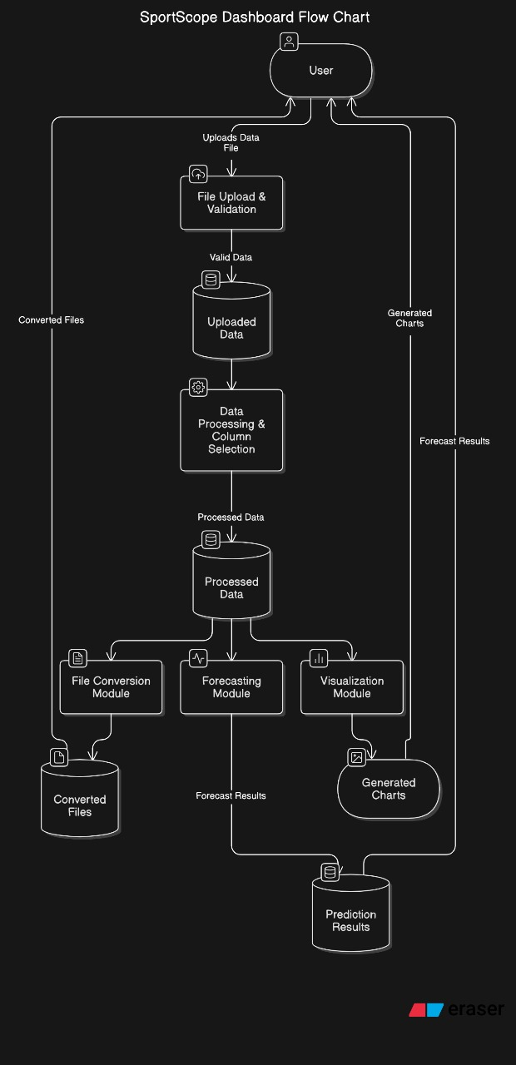
Data Flow Diagram (DFD)
DFD Level 1

Slide 10
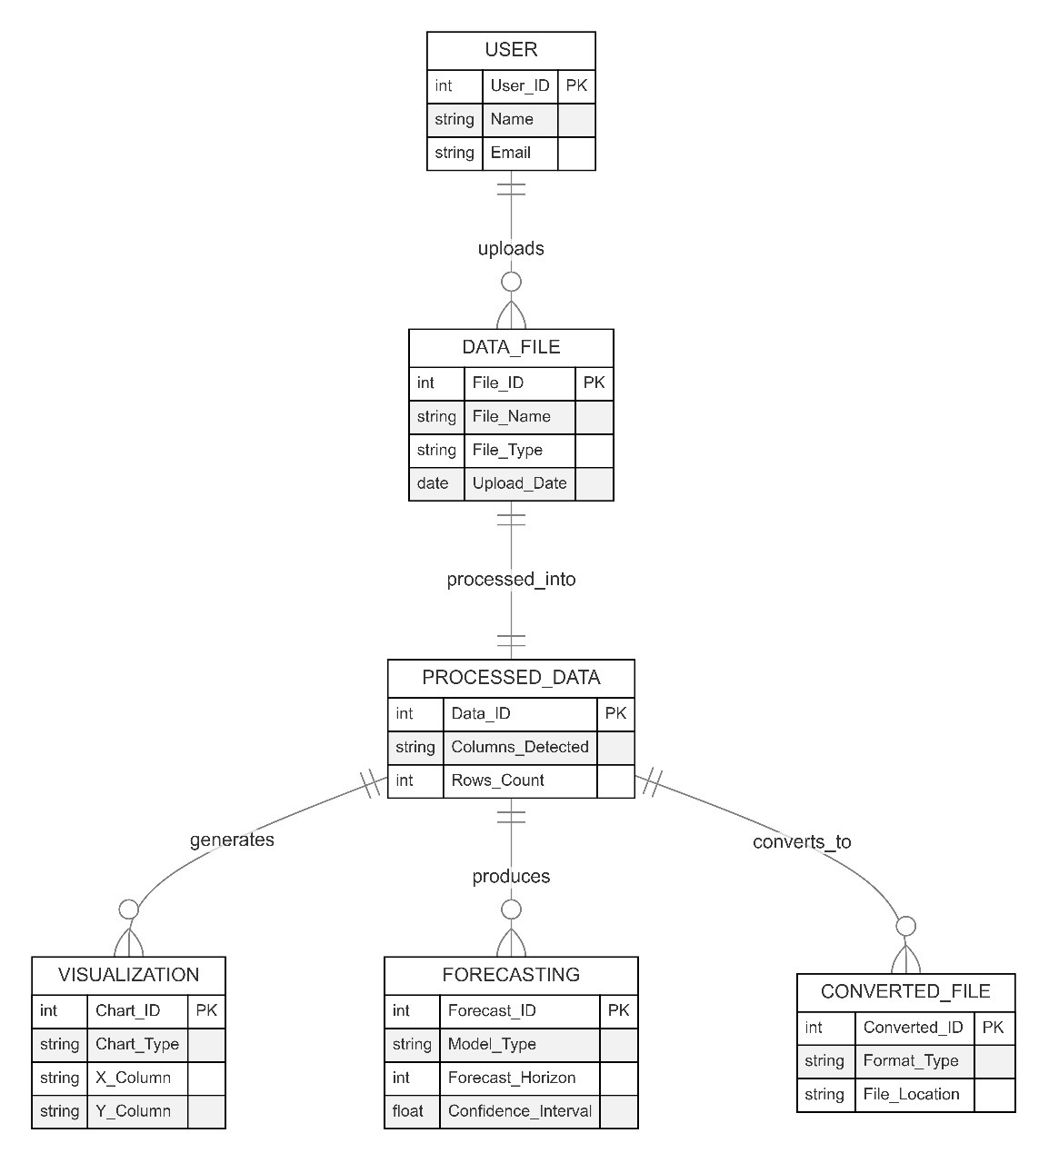
ER Diagram
Entity Relationship Diagram (ERD) Overview

Slide 11

Summary & Next Steps
1
2
Unified Tool
Empowering Users
Sport Scope Dashboard brings together data upload, visualization, forecasting, conversion, and dashboards.
Non-technical users can leverage machine learning and visualization for insightful data analysis.
3
Next Steps
Join us for a demo of Sport Scope Dashboard to explore its features and capabilities.

